Slide 1
analysis presentation – E-Commerce

Slide 2
Executive summary
The company demonstrates strong operational efficiency, with delivery times improving from 19.8 to 12 days and high customer satisfaction (avg. score ~4.0).
Revenue grew sharply through 2017, showing clear seasonal peaks, but declined 37.5% after Oct 2017.
High-value categories like Computers deliver strong revenue per order but suffer from low volume, limiting impact.
Rising cancellations (from 254 to 290/month) suggest fulfillment or expectation gaps.
To optimize performance, I recommend addressing cancellation causes, boosting high-margin low-volume items, and leveraging Q2 seasonal demand.

Slide 3
Product Performance Insights
Categories performance led by :
Health Beauty, Watches Gifts, Bed bath Table, Computers Accessories, Sports Leisure – with combined 6.1M$ in Revenue(40% of Total), 38.2K Orders (38% of Total) Averaging 4.02 in Review Score.
Top categories in Revenue per Order are Low-Performing:
Computers – 1,367$ per order(+782% from average), only 181 orders and 247.5K $ Revenue.
Small appliances home oven & coffee – 640$ per order(+313% from average), only 75 orders and 48K $ Revenue.
Fixed Telephony – 593$ per order(+288% from average), only 217 orders and 129K $ Revenue.
Agro Industry – 503$ per order(+229% from average), only 182 orders and 92K $ Revenue.
Home Appliances 2 – 487$ per order(+218% from average) , only 234 orders and 114K $ Revenue.
Top categories in Review Scores are extremely Low-Performing:
Cd’s DVD Musical, Fashion Children’s Clothes, Books General Interest, Construction Tools, Flowers –
Averaging 4.49 Review Score, with Median orders amount of 29.

Slide 4
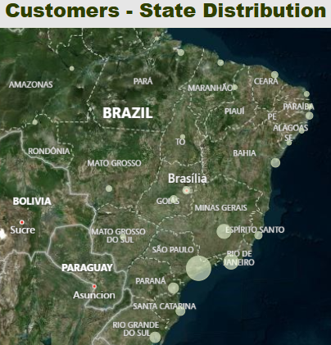
Delivery performance & states distribution
Most of the Customers ate concentrated in the following states:
Sau Paulo – 41,746 Customers (42% of Total)
Rio de Janeiro – 12,852 Customers ( 13% of Total)
Minas Gerais – 11,635 Customers( 12% of Total)
The same states are leading also with the delays amount –
Sau Paulo with 2,685 delays(1 delay for every 15.5 customers), Rio de Janeiro with 1846(1 delay for every 7 customers) and Minas Gerais with 707 delays(1 delay for every 16.5 customers)
In terms of delivery speed, the slowest delivery is to states like :
Roraima, Amapá, Amazonas, Alagoas, Pará –averaging delivery time of 26.2 Days.
The fastest delivery is to:
Sao Paulo, Paraná, Minas Gerais –averaging delivery time of 10.8 Days.

Slide 5
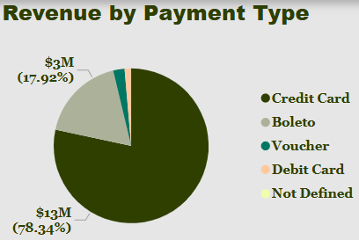
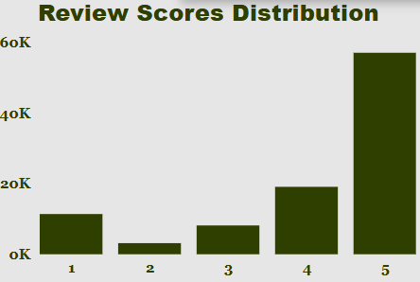
Review scores & payment methods correlations
Review Scores Distribution: 58% Scored as 5, 19% Scored 4, 12% Scored 1.
Average Review score mostly dragged down because categories like:
Office furniture – averaging 3.49 score with 1,273 orders.
Bed Bath table – averaging 3.9 score with 9,417 orders.
Furniture Decor – averaging 3.9 score with 6,449 orders.
Computers Accessories – averaging 3.93 score with 6,689 orders.
There are 2 main Payment Methods that generate the most Revenue and are used the most:
Credit card – 73% of transactions with 78% of Revenue.
Boleto – 19% of transactions with 18% of Revenue.

Slide 6
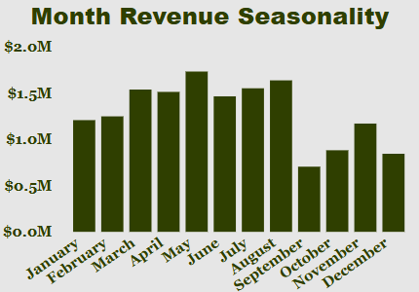
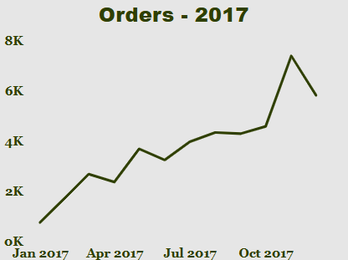
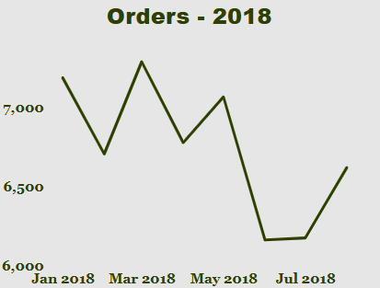
Key trends overview
Overall Revenue growth :
Avg. revenue per month rose sharply from $42.4K in 2016 to $8.38M in 2018 – 2017 was a break-out year.
Operational improvement:
Avg. delivery time improved from 19.8 days in 2016 to 12 days in 2018, consistently faster than the estimated delivery time.
Customer satisfaction maintained:
Avg. review score improved from 3.49 (2016) to ~4.0 (2017–2018), despite significant growth in orders.
Cancellations increased:
Monthly cancellations rose from 254 (2017) to 290 (2018).
Seasonality consistent:
Revenue peaks during April–June, dips around August–September, showing strong seasonal trends.
Post-Nov 2017 decline:
After peaking in Oct 2017 (~$9.6M revenue), monthly sales declined by 37.5% until August 2018.

Slide 7
Key strengths & weaknesses
Strengths
Operational Efficiency & Fast Delivery
-Delivery times improved from 19.8 to 12 days, outperforming expectations and reducing customer wait time.
Strong Revenue Growth with Clear Seasonality
-Monthly revenue increased sharply year-over-year, with predictable seasonal peaks enabling better planning.
High Customer Satisfaction at Scale
-Despite rapid order growth, average review scores remained stable around 4.0 with 58% of customers rating 5.
Weaknesses
Revenue and Orders Declining Post-Oct 2017
-After a peak in Oct 2017, revenue dropped 37.5% by Aug 2018, indicating potential market saturation or demand loss.
High-Value Low-Performing Product Categories
-Categories with high revenue per order (e.g. Computers) showed low volume, limiting overall impact.
Rising Cancellation Rates
-Monthly cancellations increased from 254 to 290, signaling possible issues with fulfillment or customer expectations.

Slide 8

recommendations
Short – Range
1. Investigate and Address Rising Cancellations
Conduct a root-cause analysis on why monthly cancellations rose from 254 to 290.
Focus on product availability, delivery delays, or mismatched expectations.
2. Boost High-Value Low-Volume Categories
Run short-term marketing or discount campaigns to promote high-margin categories (e.g., Computers, Home Appliances) to increase volume and ROI per order.
3. Leverage Seasonal Peaks
Prepare focused campaigns for Q2 (April–June), based on consistent seasonal spikes.
Adjust inventory, staffing, and marketing for high-conversion periods.
Mid – Range
1. Develop High-Volume Product Bundles
Create product bundles that combine high-volume items (e.g., Bed Bath Table, Accessories) with high-value items to increase average order value and volume.
2. Expand Top-Performing States with Fast Delivery
Capitalize on strong delivery metrics in Sao Paulo, Paraná, and Minas Greias by expanding marketing and logistics efforts there to increase penetration.
3. Analyze Post-2017 Decline & Optimize Funnel
Deep-dive into the revenue/order drop after Oct 2017. Investigate funnel friction: lead sources, conversion rates, cart abandonment, and customer churn.

